Slide 1


Scalable Front-end Development with Vue.JS
Galih Pratama
Head Front-end Developer at

Slide 2
Who are you?

Slide 3




Galih Pratama
Front-end Developer with 30+ web/apps developed.
Tech-based Edu Content Creator with 100+ videos created, since 2011.
Current Work / Projects

Slide 4
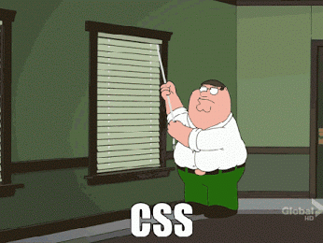
Me in a nutshell

Slide 5
Current State of Javascript

Slide 6
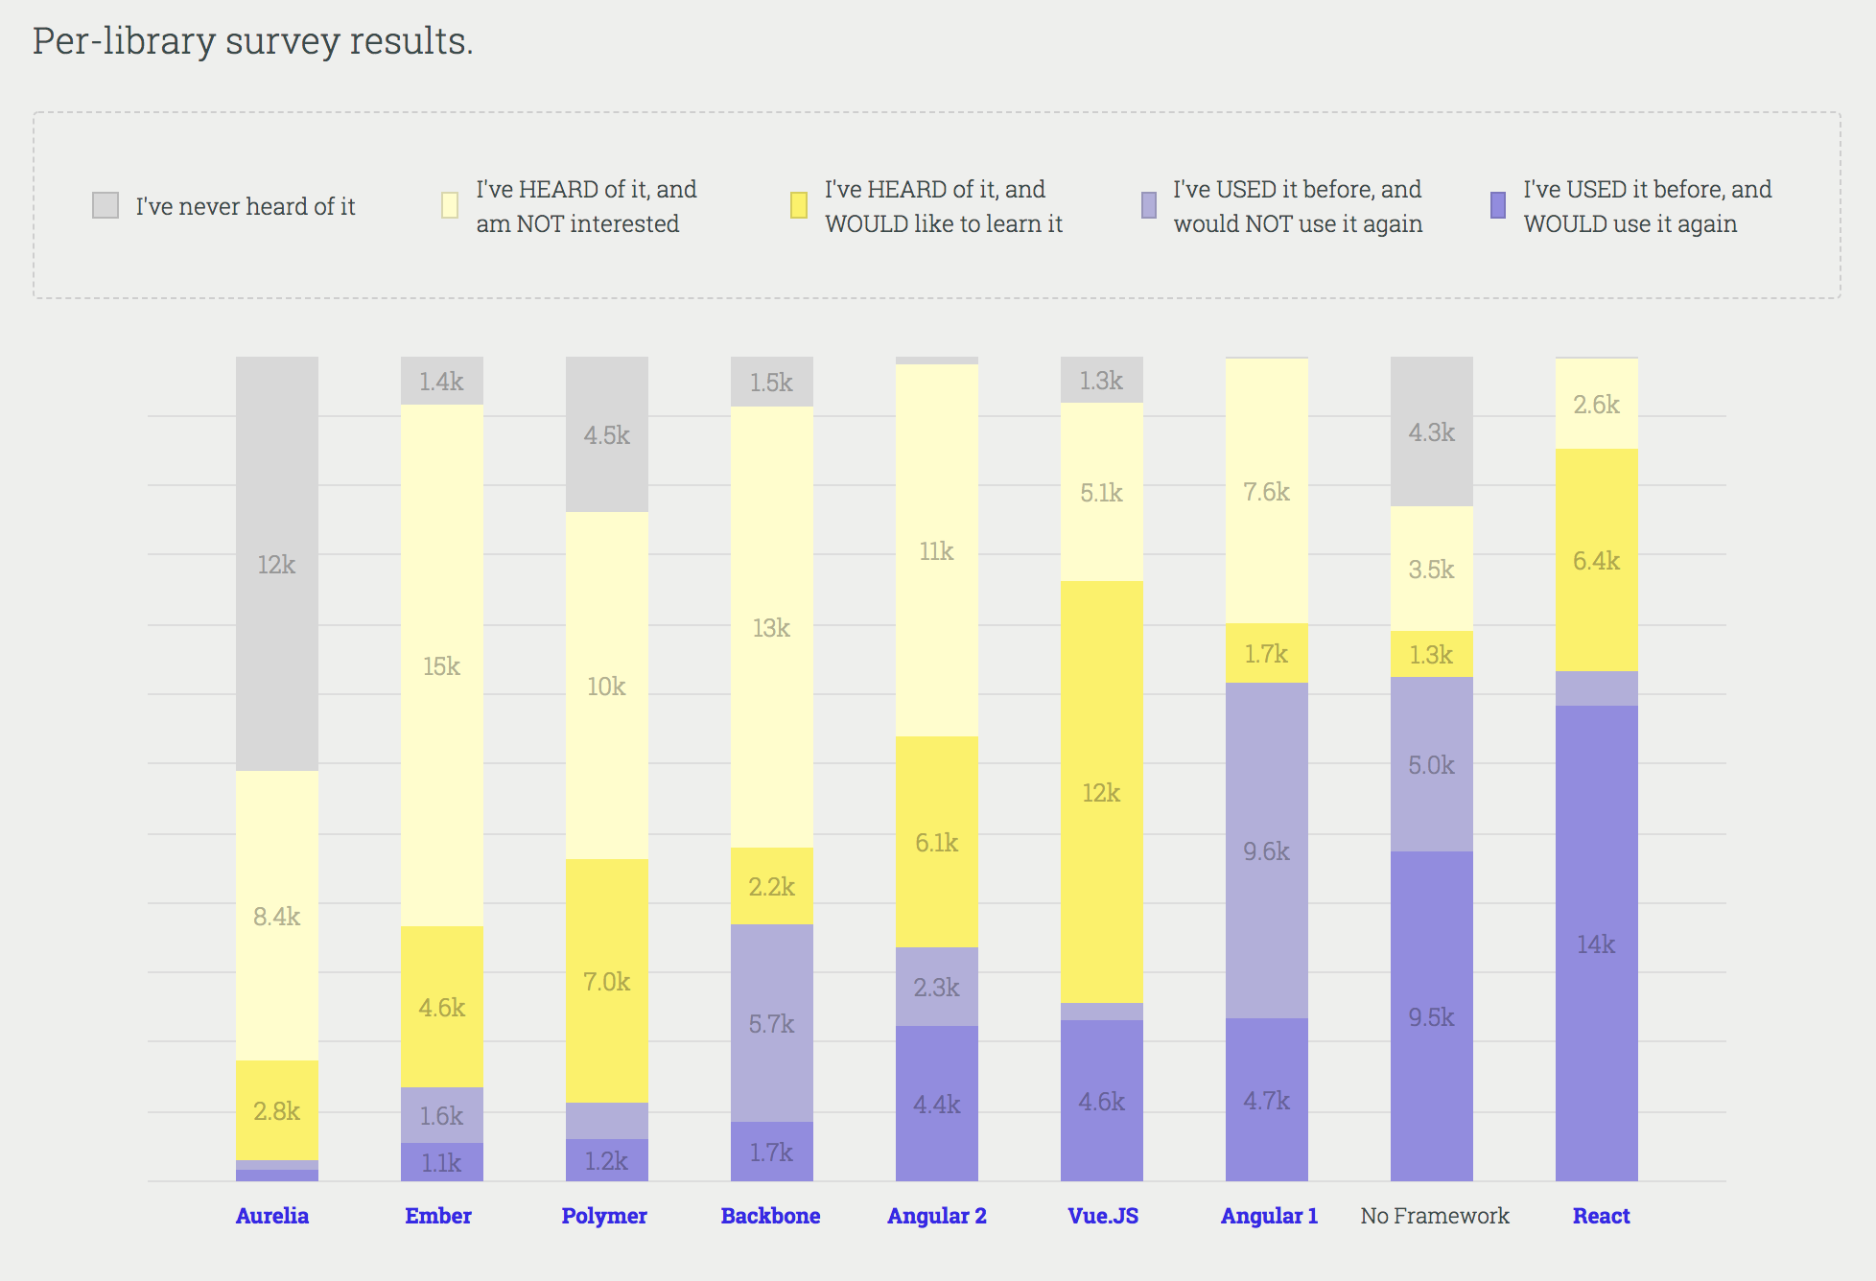
stateofjs.com/2017/front-end/results

Slide 7
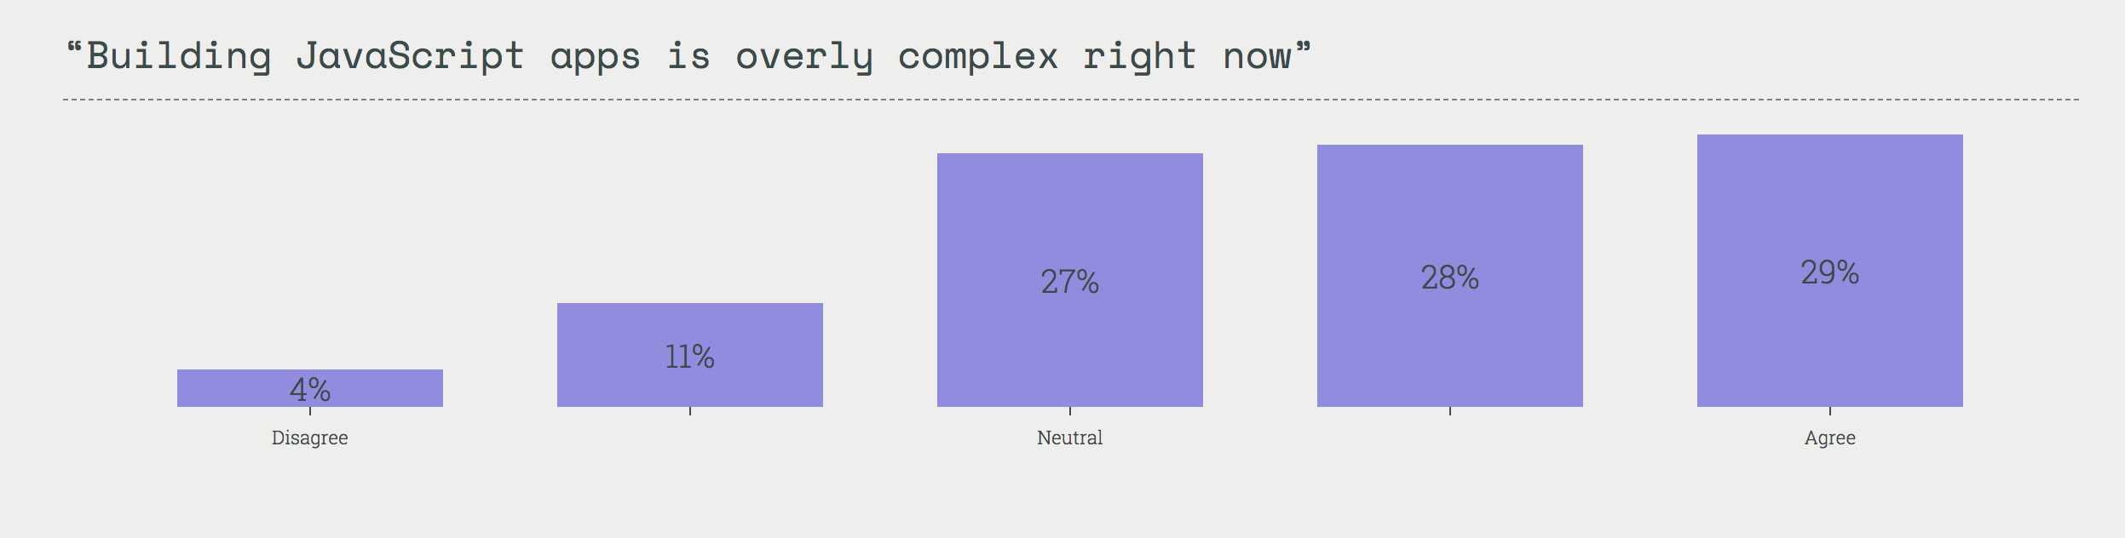
stateofjs.com/2017/opinions

Slide 8
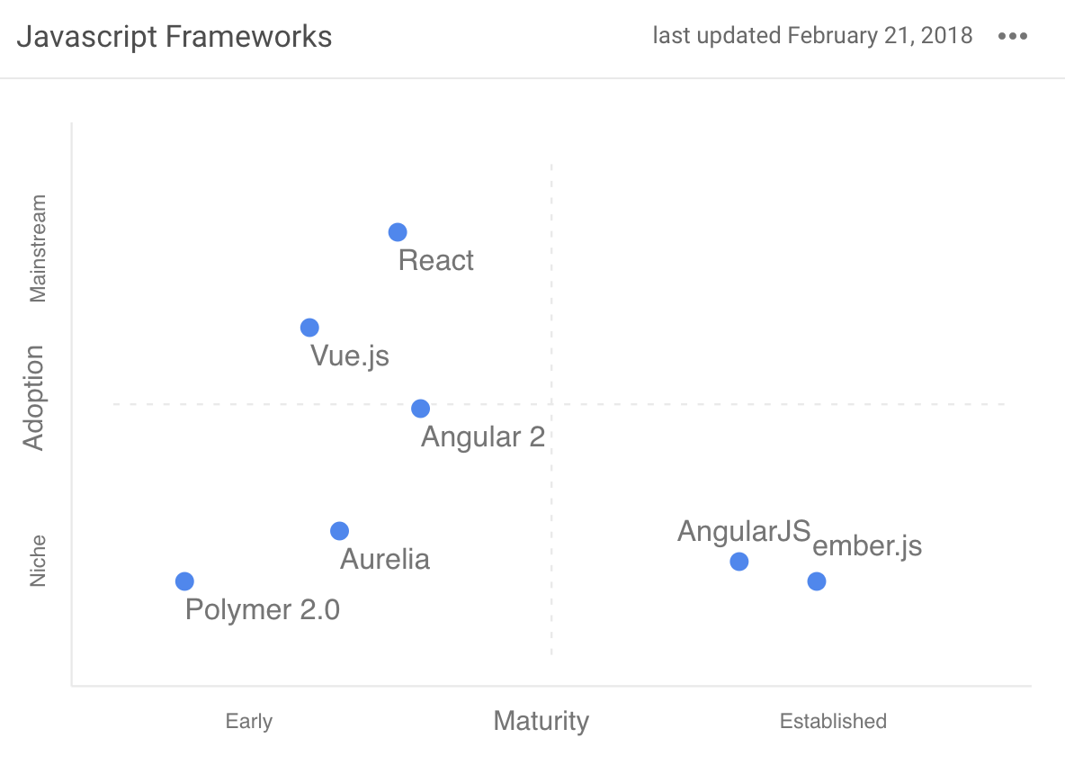
stateofdev.com/c/frontend

Slide 9
What is “Scalable Development” means?

Slide 10
Improve development speed

Slide 11
Decrease future technical debt

Slide 12
Modular

Slide 13
Good programming pattern

Slide 14
Not over-engineering things

Slide 15


Slide 16
Why Vue.JS?

Slide 17
You can use it simply like this...

Slide 18
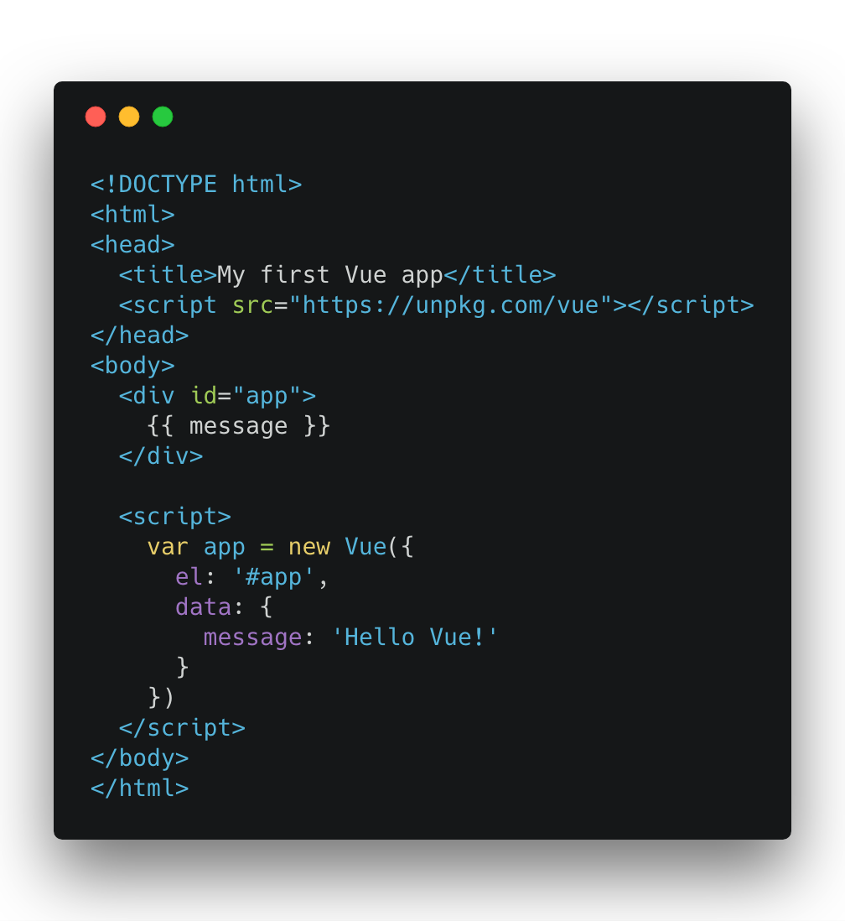

Slide 19
...or like this...

Slide 20
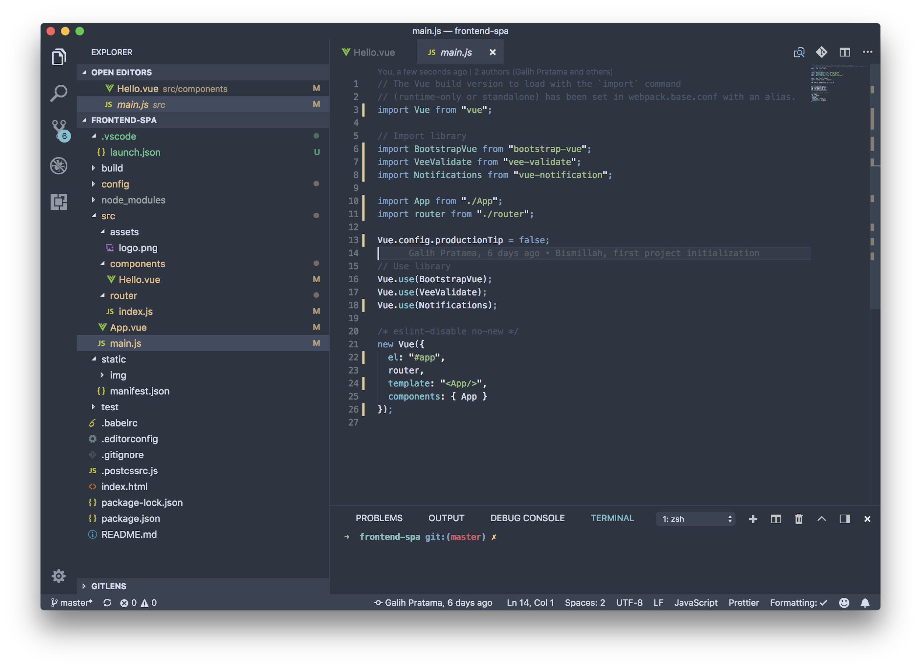

Slide 21
Learning curve is easy
Simplicity
Hot reload
Write HTML like an usual
Flexible
Single page apps
Vue Devtools
Can used on existing app
Small file size
Less boilerplate code
Fun
Two-way data binding
Vuex
Detailed documentation
Reactive
vue-cli

Slide 22
Single Page Apps (SPA)

Slide 23
Why SPA?

Slide 24
App rendered in browser

Slide 25
Less server overhead
(no need to render anything in server, only serve html/css/js)

Slide 26
Separation of Concerns
(frontend do frontend, backend do backend)

Slide 27
Routing? Included.
vue-router

Slide 28
Wuzz wuzz

Slide 29
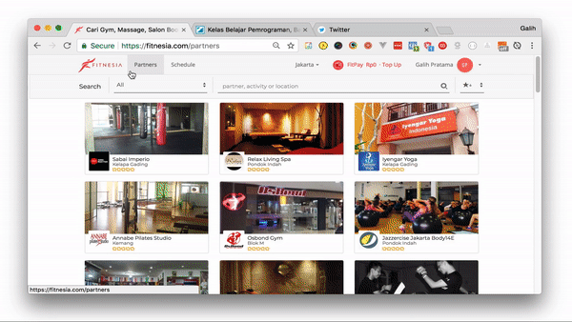

Slide 30
Vue Devtools
Makes developing on Vue.js even easier than it already is.

Slide 31
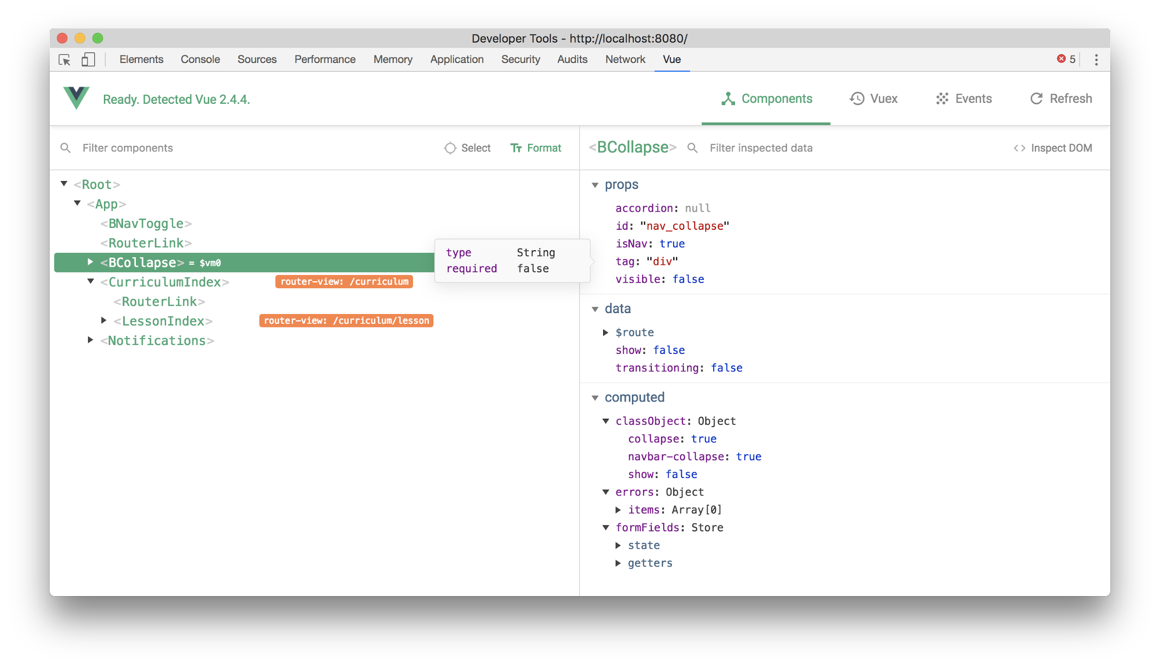

Slide 32
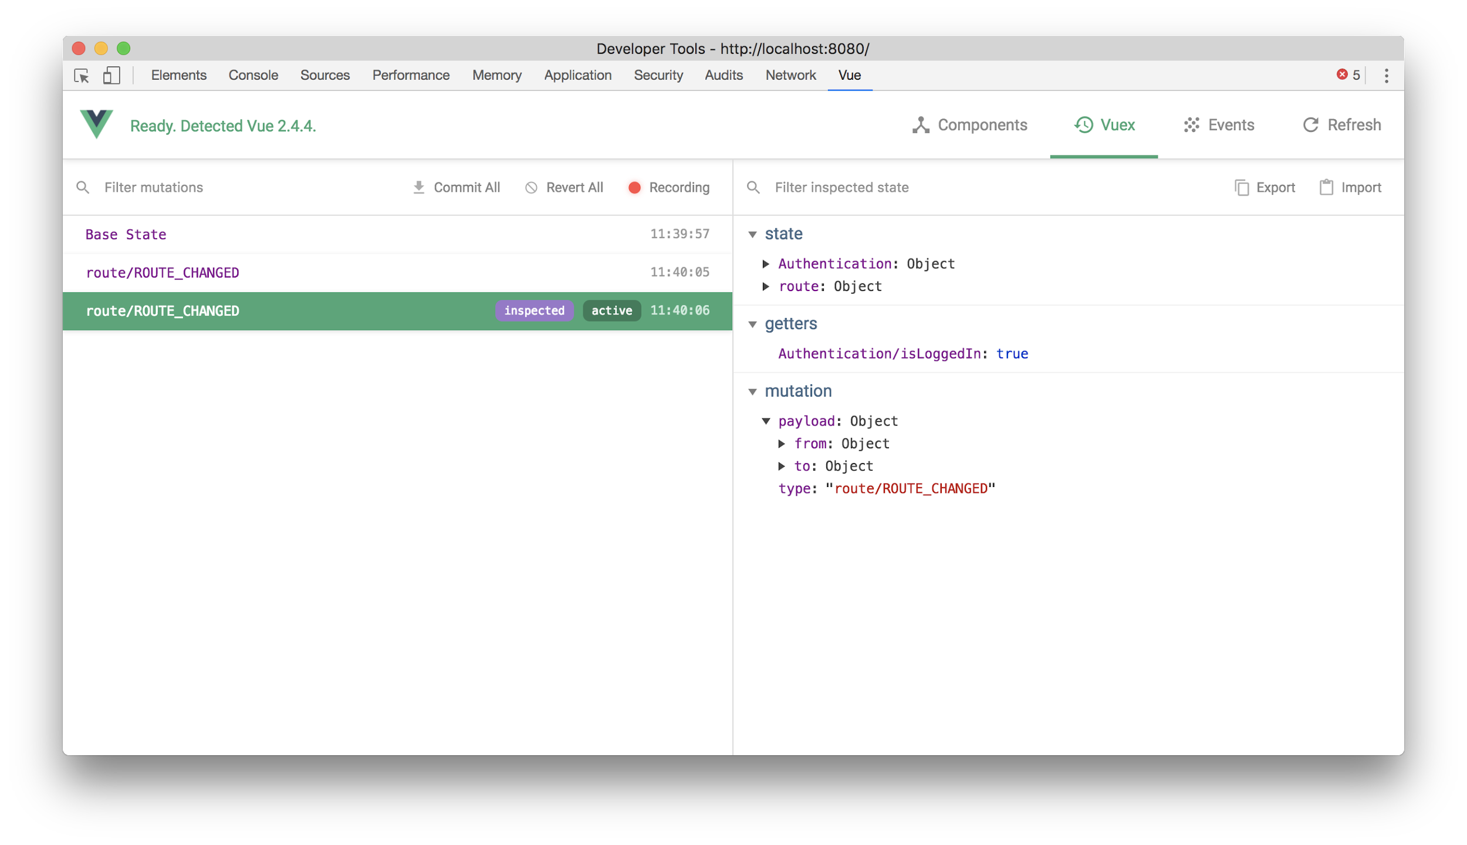

Slide 33
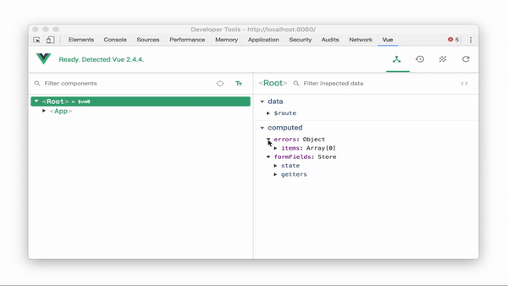

Slide 34
vue-cli
A simple CLI for scaffolding Vue.js projects.

Slide 35
vue init <templatename> <projectname>

Slide 36
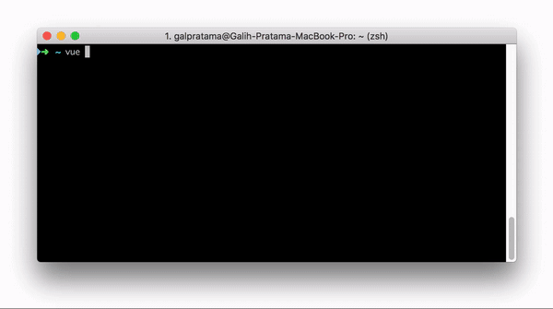


Slide 37
You can use it in any way!
webpack A full-featured Webpack + vue-loader setup with hot reload, linting, testing & css extraction.
webpack-simple A simple Webpack + vue-loader setup for quick prototyping.
browserify A full-featured Browserify + vueify setup with hot-reload, linting & unit testing.
browserify-simple A simple Browserify + vueify setup for quick prototyping.
pwa PWA template for vue-cli based on the webpack template
simple The simplest possible Vue setup in a single HTML file

Slide 38
Vuex
Vue.js on Steroids

Slide 39
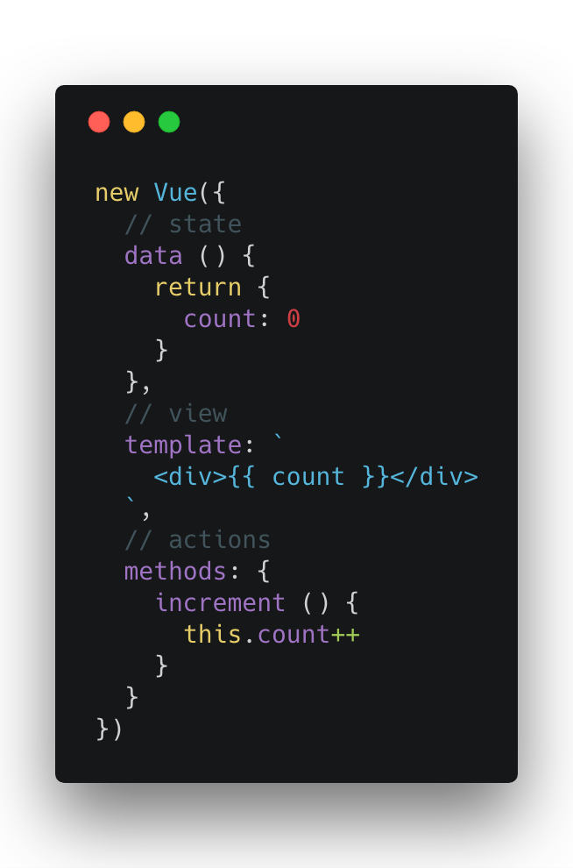
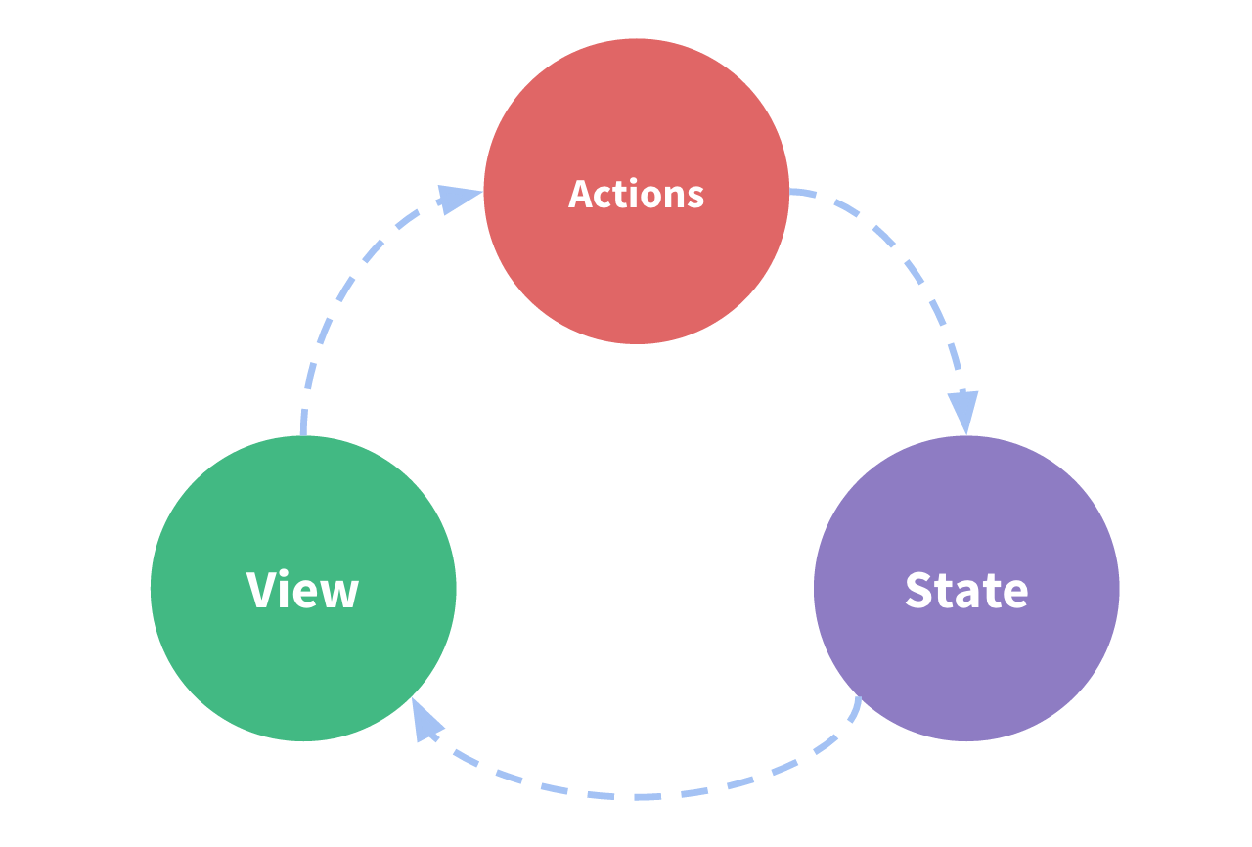
How Vue.js “one-way data flow” lifecycle works

Slide 40
The problem?

Slide 41
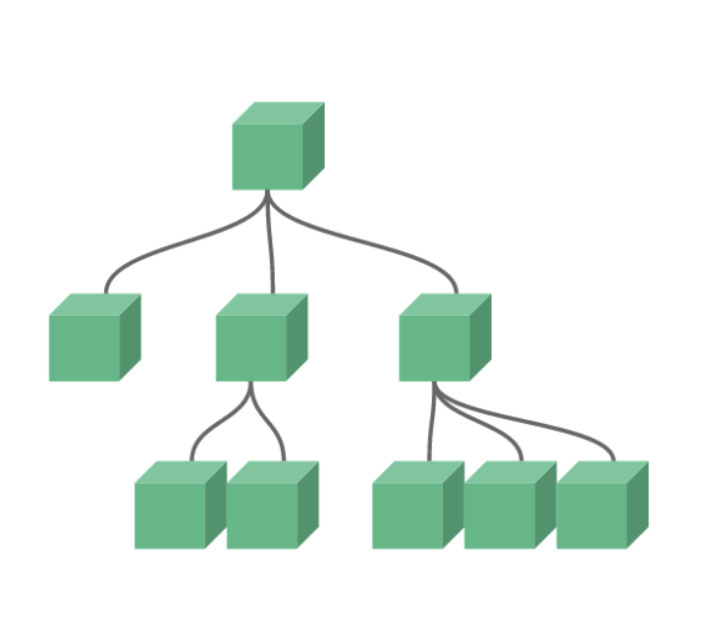
How to handle this?
> One state for multiple component
> Reusable action from different component

Slide 42
Solution?

Slide 43
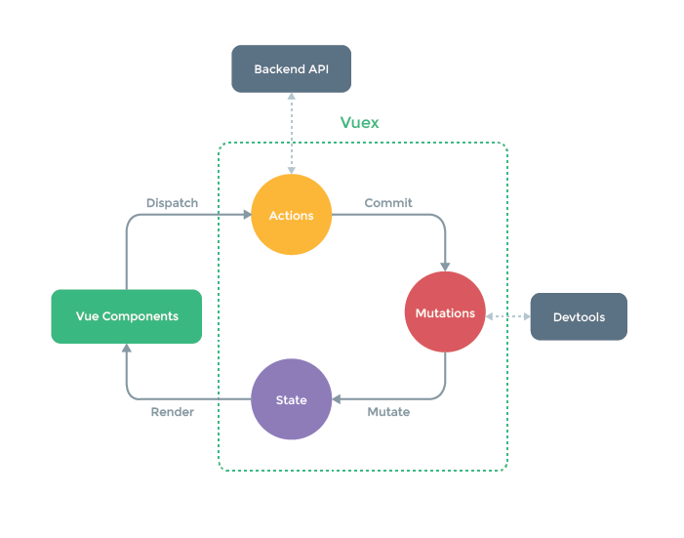

Slide 44


Slide 46
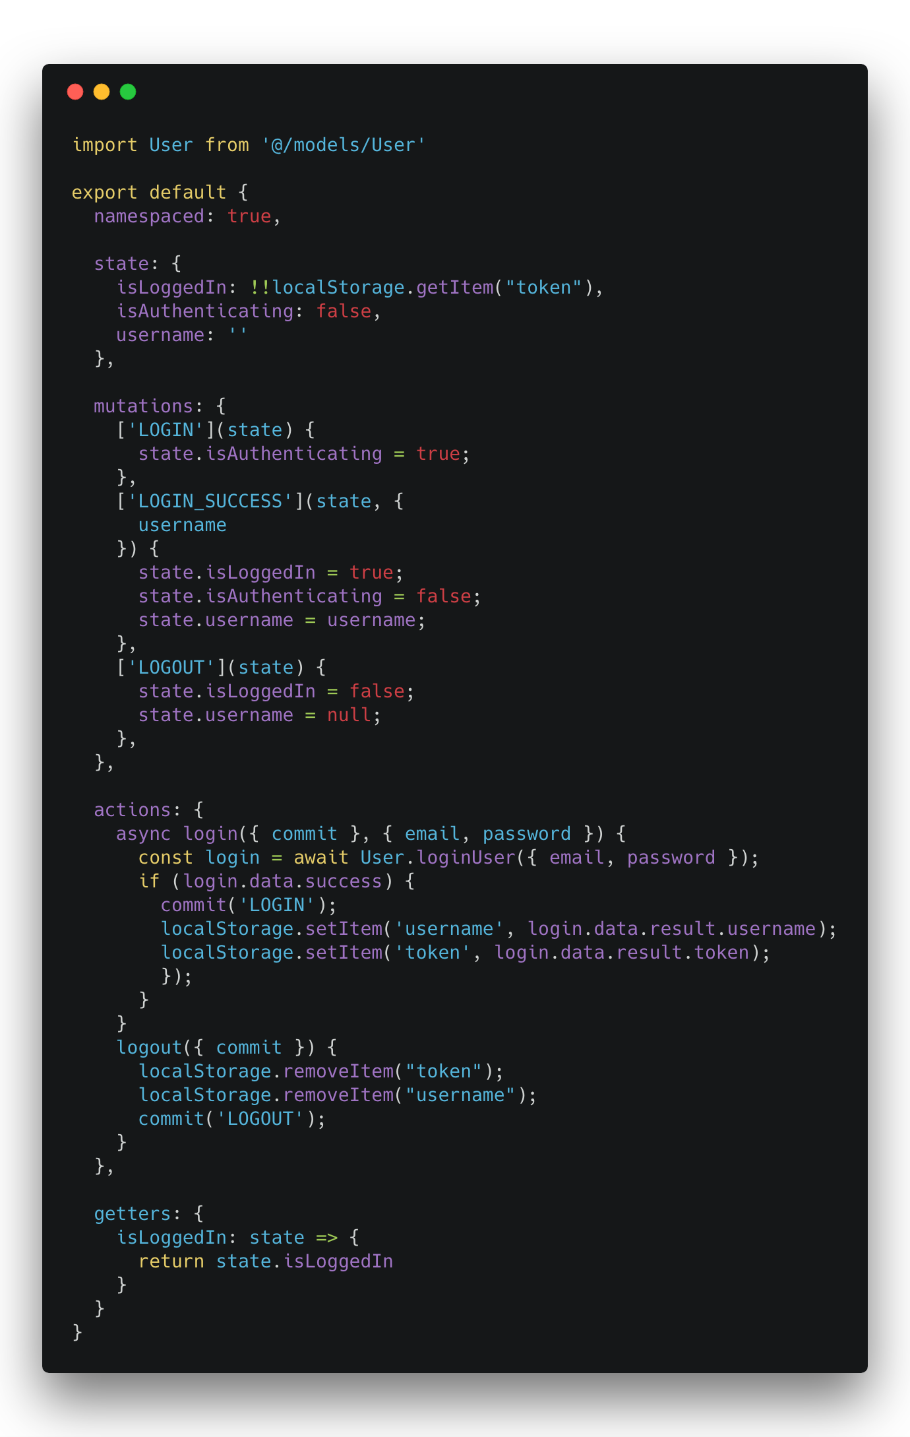
Vuex Store
A place to “store” globally in your app

Slide 47
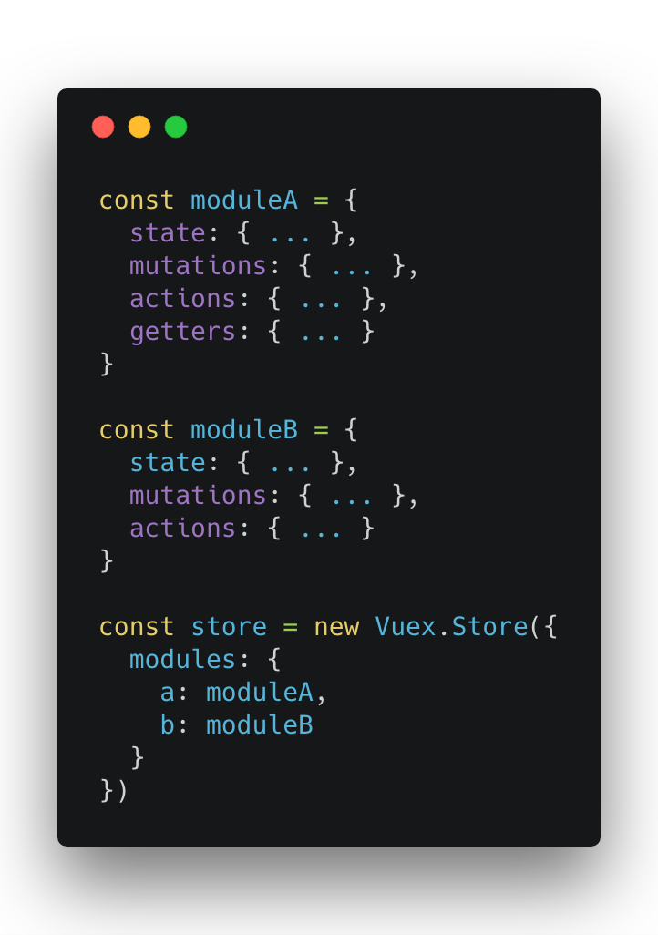

Slide 48
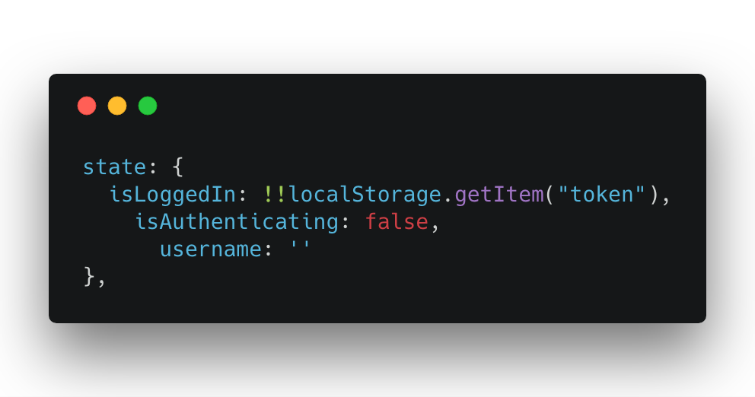
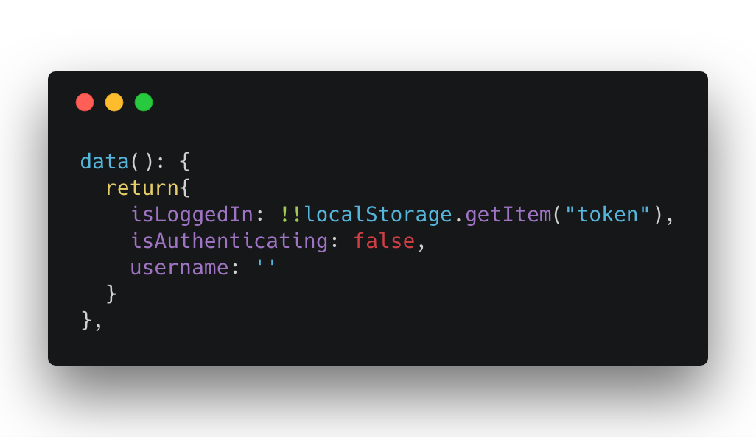
Vuex State
Vue Data

Slide 49
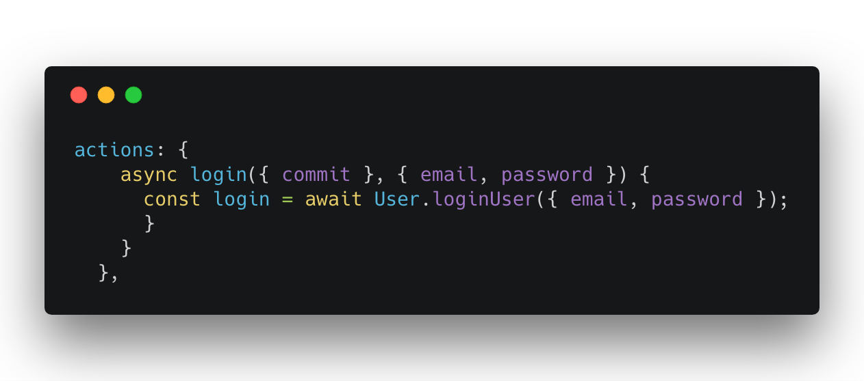
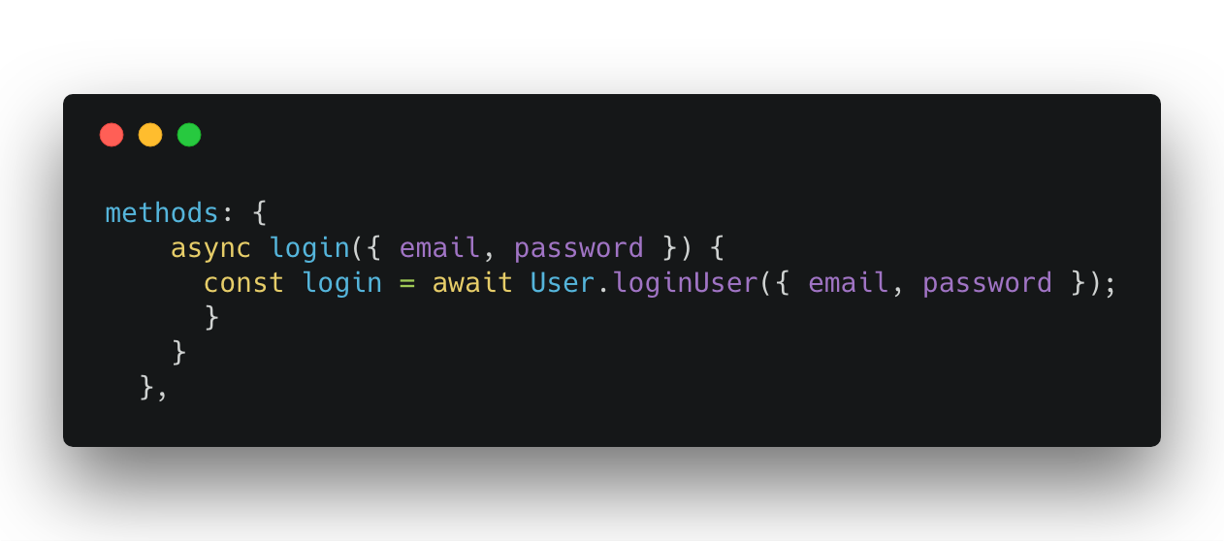
Vuex Action
Vue Methods

Slide 50
How About SEO?

Slide 51
Google(bot) can index Single Page Apps

Slide 52
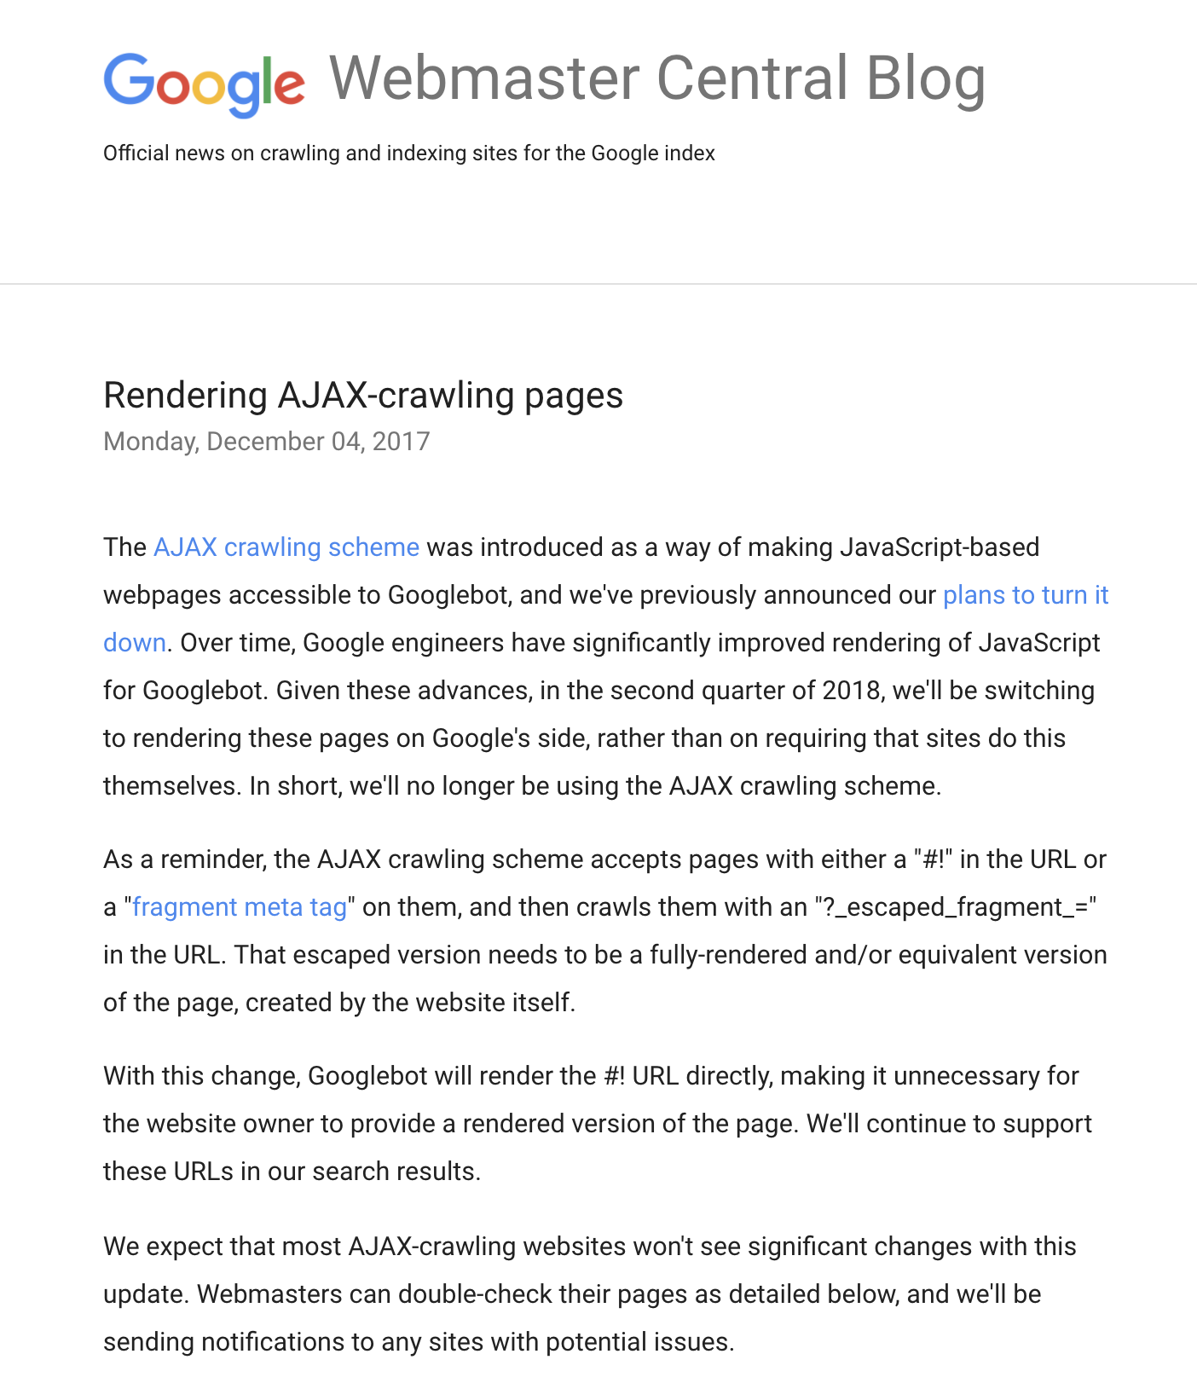
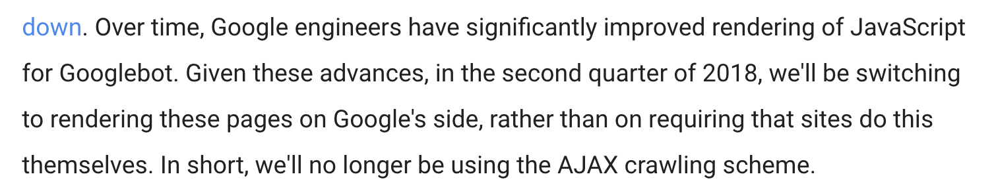

Slide 53
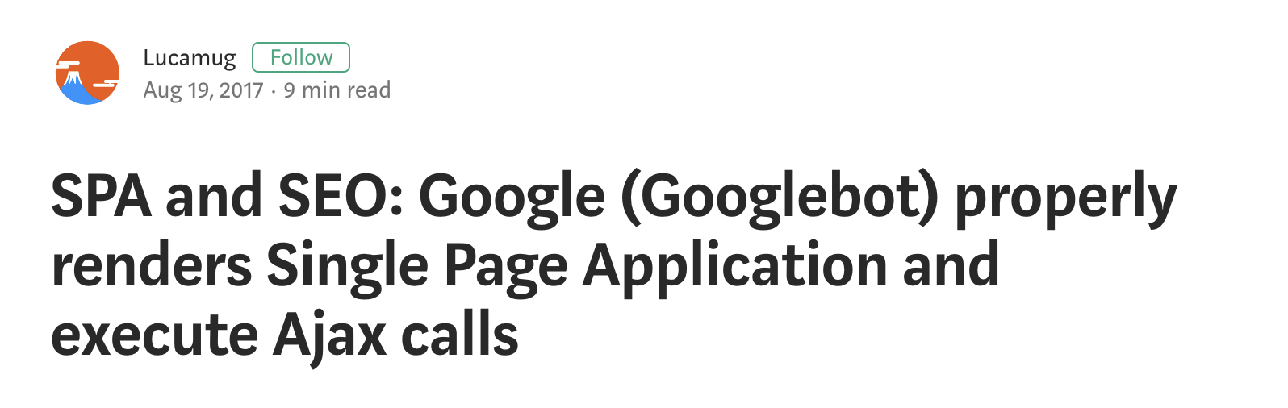

Slide 54
SPA & Googlebot
Googlebot run the Javascript on the page and the Ajax calls are properly executed
Googlebot waits between 5 to 20 seconds before taking a snapshot of each page
More : https://medium.com/@l.mugnaini/spa-and-seo-is-googlebot-able-to-render-a-single-page-application-1f74e706ab11

Slide 55


Slide 56
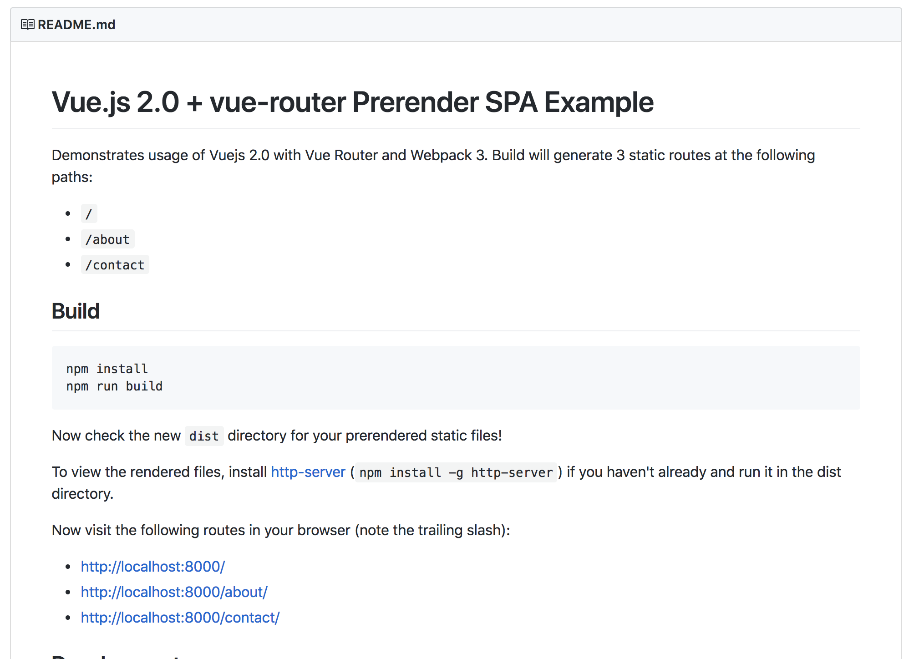
Prerender?
Use prerender-spa-plugin

Slide 57

Server-side rendering?
Use Nuxt.js instead

Slide 58
Conclusion

Slide 59
Conclusion
Building javascript apps is somewhat confusing
Need to scale up without make it more complicated.
Vue.JS make it easier without sacrificing scalability.
Official project generator using vue-cli
Ready to use devtools with zero configuration
Use Vuex in large-scale apps
SEO is safe (like Google said)

Slide 60
Thank….

Slide 61
… one more thing

Slide 62

Want to know how
to build it ?

Slide 63



Thank you!
Questions?
galpratama
pratama.galih
hi@galihpratama.net

